Slide 1


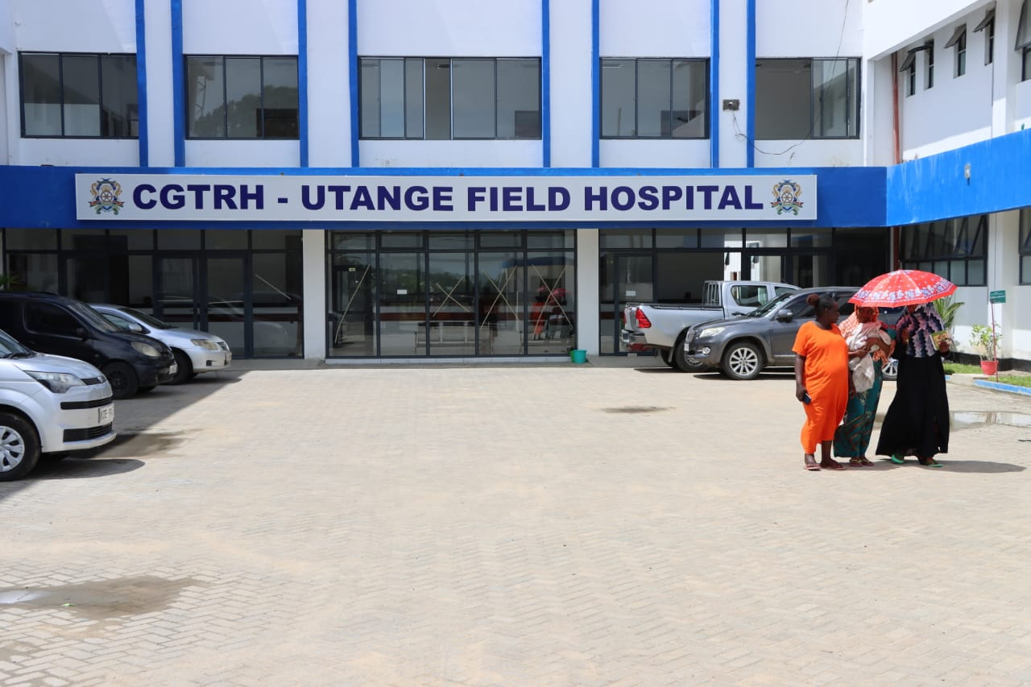
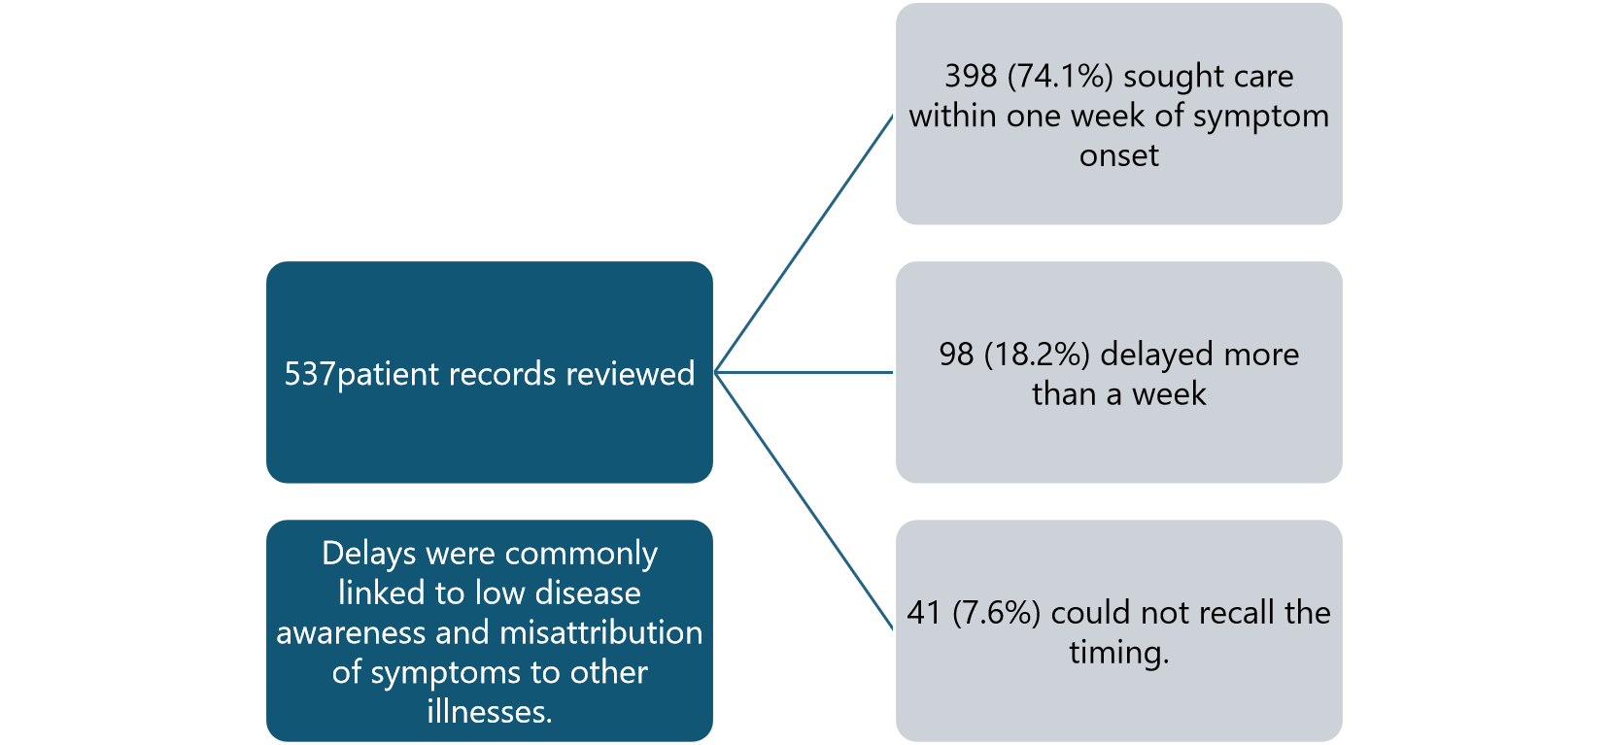
INSERT YOUR INSTITUTIONAL LOGOx
INSERT YOUR INSTITUTIONAL LOGO
Healthcare-Seeking Behavior Among Mpox Patients During the 2024 Outbreak in Mombasa, Kenya: A Case Study from Utange Field Hospital
Halima mwamguta¹ ,Anthony Boniface² and Dr.Khadija Sood³
1:Mombasa County,. 2:Department of Health 3: Coast General Teaching and Refferal Hospital, 4: Utange Field Hospital
BACKGROUND
Since July 2024, Kenya has experienced an Mpox outbreak caused by a newly identified Monkeypox virus (MPXV) variant, believed to have originated in the Democratic Republic of the Congo and spread across multiple countries. The first confirmed Kenyan case was reported on July 21, 2024, followed by a steady rise in incidence. Health authorities responded with enhanced surveillance, contact tracing, and vaccination in the most affected regions. At Coast General Teaching and Referral Hospital (CGTRH)–Utange Field Hospital, 537Mpox patients have been admitted, with cases reported across several Mombasa sub-counties. Upon admission, both patients and caregivers exhibited limited awareness of Mpox.
OBJECTIVE:
To assess delays in healthcare seeking behavior among Mpox patients admitted to the Utange isolation unit and identify reasons for delayed presentation.
A retrospective review of clinical records was conducted for patients admitted with Mpox. In-depth interviews were held during admission assessments and daily ward rounds. Data on symptom onset and timing of healthcare engagement were collected and analyzed.
METHOD:
STUDY AREA:Utange field Hospital, Mombasa
RESULTS
CONCLUSIONS
A substantial number of patients delayed seeking care, often presenting with advanced symptoms, complicating treatment and recovery. Strengthening public health education on Mpox symptoms particularly how to differentiate them from other sexually transmitted infections is critical for early diagnosis, effective clinical management, and outbreak control.
* …………
Contact: halimasalim046@gmail.com

Slide 2

Poster Size Guideline

